Slide 1
The Cloud Platform for Document Process Automation
Jean-Michel Bérard, Founder & CEO
Emmanuel Olivier, COO
March 2019

Slide 2
Agenda
Corporate Overview
Key Figures
Strategy
Addendum

Slide 3
Corporate Overview
The Cloud Platform for Document Process Automation

Slide 4


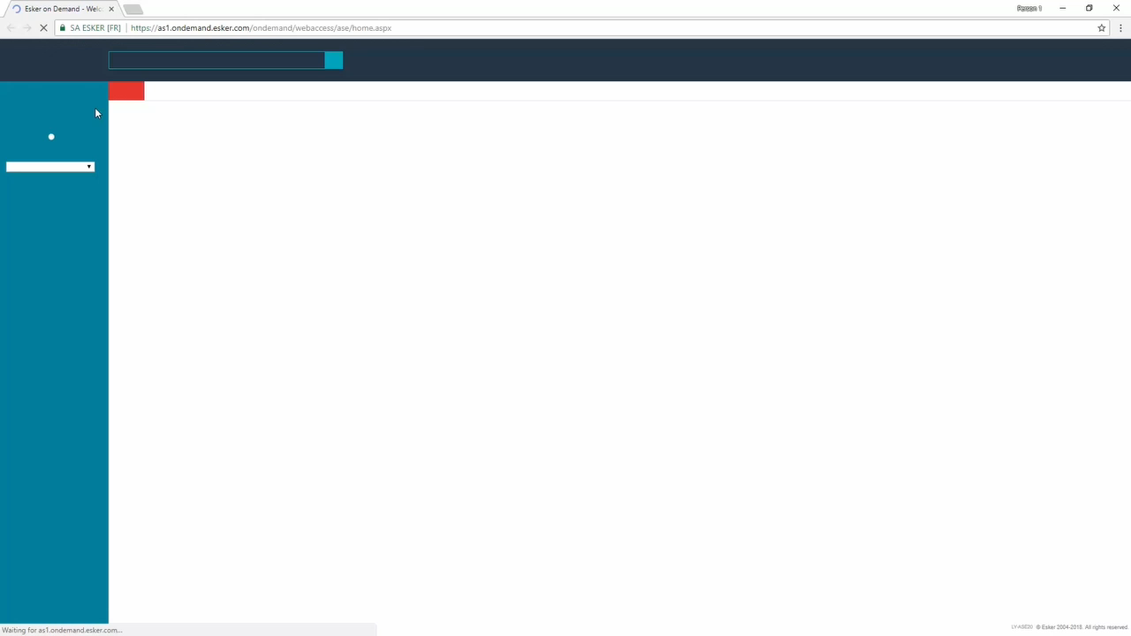

BRINGING THE
BACK-OFFICE TO THE
MODERN WORLD

Slide 5

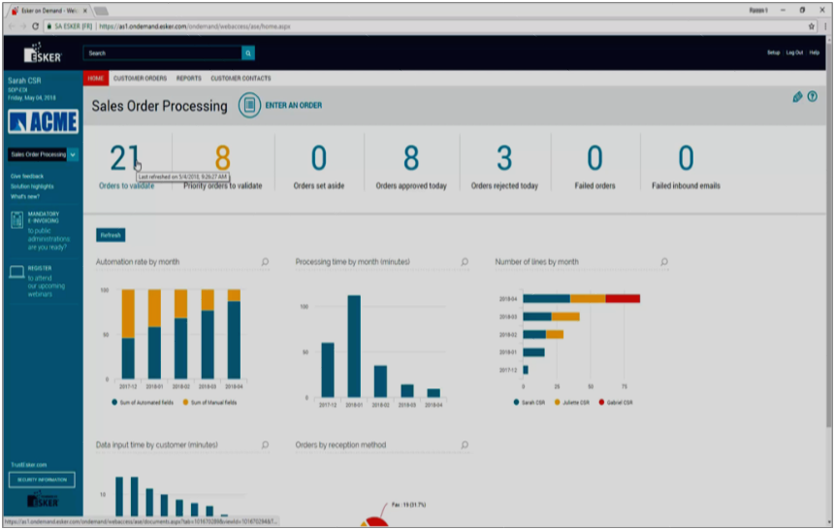

DIGITALISATION of exchanges
Between companies and
their Clients/suppliers
ORDER-TO-CASH
PURCHASE-TO-PAY
Order Management
Purchasing
Accounts Receivable
Accounts Payable & Financing

Slide 6



A Unified Cloud Platform
ACCOUNTS RECEIVABLE
PURCHASING
ORDER-TO-CASH
PURCHASE-TO-PAY
Your
Customers
Your
Suppliers
Your
company
ORDER MANAGEMENT
ACCOUNTS PAYABLE & FINANCING
TO AUTOMATE
O2C & P2P CYCLES
Customers
Suppliers

Slide 7
Drilling down further…
ACCOUNTS RECEIVABLE
PURCHASING
Payment
Purchasing
Cash
Application
Contract
Management
Accounts
Payable
Cash
collection
ORDER-TO-CASH
PURCHASE-TO-PAY
SIM
Supplier
Information
Management
Expense
Management
Invoice
delivery
Your
customers
CIM
Customer
Information
Management
Supply Chain
Financing
Your
company
Your
suppliers
Claims
& Deductions
Payment
Order
Management
ORDER MANAGEMENT
ACCOUNTS PAYABLE & FINANCING
Customers
Suppliers
O2C AND P2P
AUTOMATION

Slide 8
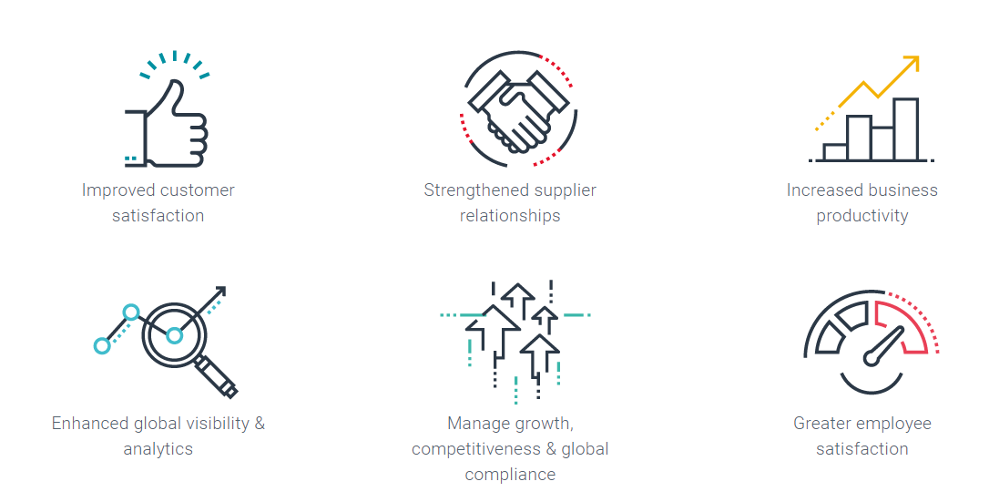
Digital Transformation of the Cash Conversion Cycle
Enhanced global visibility & analytics
Increased business productivity
Manage growth, competitiveness & global compliance
Improved customer satisfaction
Strengthened supplier relationships
Greater employee satisfaction

Slide 9
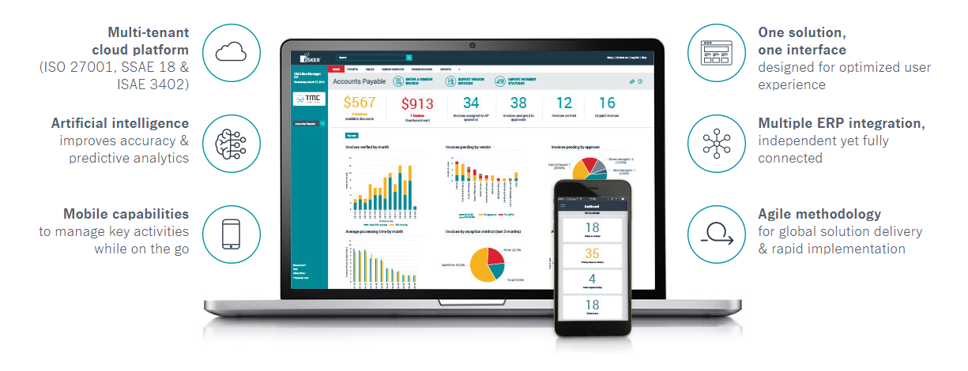
WHY ESKER?
NOT ALL AUTOMATION SOLUTIONS ARE CREATED EQUAL

Slide 10








1 out of 4
50M
But also:
an SAP customer
& supplier
Employees dedicated to R&D
Listed on
AlterNext Paris since 1997
Transactions
managed monthly
More Options
Key Numbers
#29
570
acquired by Esker in 2015
More Options
33+
years
employees
€87M
13
Of experience
Sales revenue
2018
subsidiaries
acquired by Esker in 2017
62%
14%
ORGANIC GROWTH
16%
More Options
International Revenue
Operating
Income

Slide 11
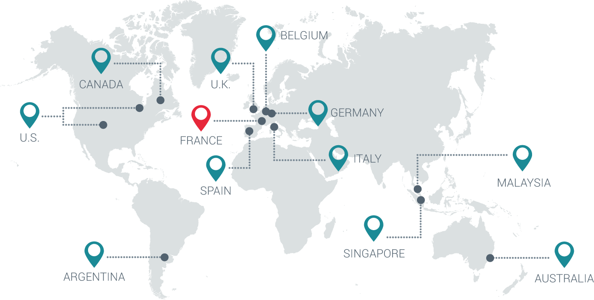
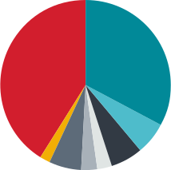


Global presence
Sales Revenue
U.S.A (38%)
France (34%)
HONG-KONG
Europe (22%)
UK, Germany, Italy, Spain
ROW & APAC (4%)
Lyon, France — HQ
Derby, UK
Munich & Düsseldorf, Germany
Madrid, Spain
Milan, Italy
Brussel, Belgium
Madison, WI & Denver, CO, U.S.
Montreal, Canada
Buenos Aires, Argentina
Sydney, Australia
Singapore
Hong-Kong
Kuala Lumpur, Malaysia

Slide 12























Recently signed customers
And many more …

Slide 13
Key Figures

Slide 14
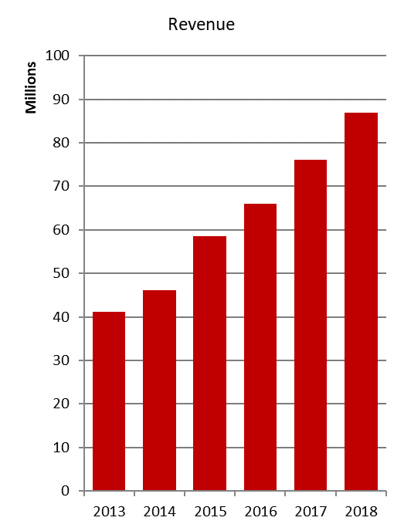
Key Figures
€87M
2018 Revenue
+16%
Organic Growth
+14%
Published Growth

Slide 15
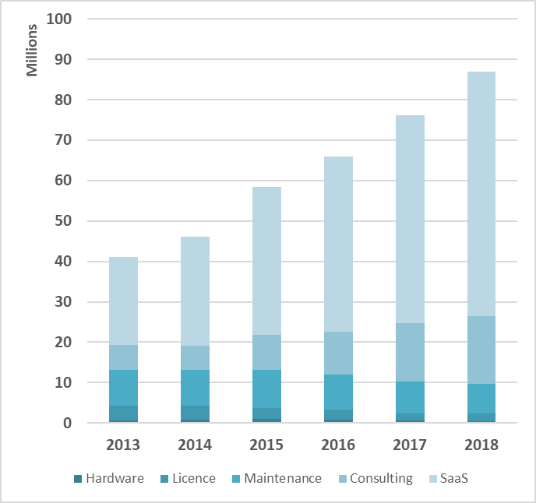
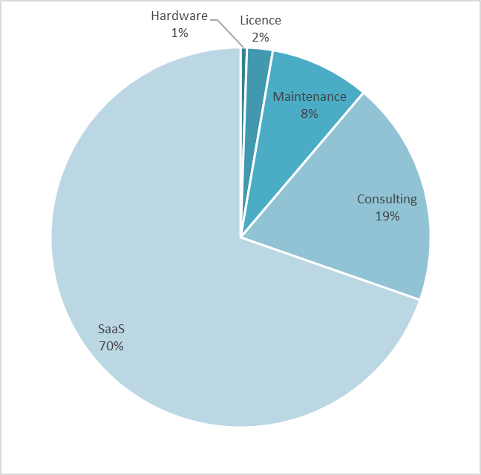
Business Model
In 2018 SaaS revenue increased by 19%
and represents 70% of the total revenue
78% recurring revenue in 2018
(SaaS + Maintenance)
Notes:
15

Slide 16
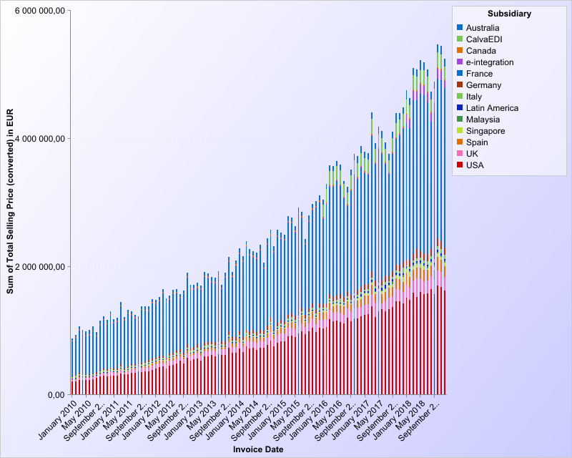
SaaS Revenue
70% of the Revenue in 2018 (excl. consulting)
€60M in 2018 (+20%)
Over 60 million pages processed every month
Around 7,000 Customers
142 million Users on our platform (500K daily users)
Monthly SaaS Revenue

Slide 17
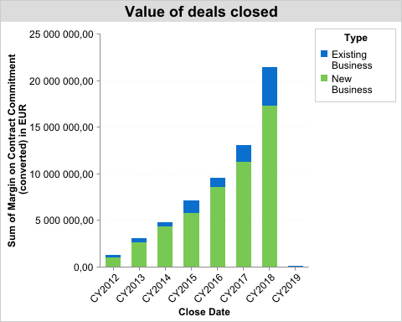
Sales Performance (bookings)
Typical contract: 3 years
Includes:
  Fixed part: subscription fee
  Variable part: per document fee
Committed value signed
  €21.5M in 2018
  +65% vs 2017
Will hit the revenue line over the next 3 years
Acquisition cost (sales & marketing mainly) charged to income statement immediately
Committed value of contract is approximately 50% of total value at contract renewal
Committed Value of Signed Contracts

Slide 18
Financial Overview

Slide 19
2018 At a Glance
Dynamic organic revenue growth +16%
  Cloud revenue growth +20%
  Other products -3%
Operating income increase by 14% to reach €11.6M
  Profitability stable at 13.3% of revenue
New customer acquisition continues to accelerate
  Value of new contracts sold grew by more than 65% vs. 45% in 2017
  Good visibility on future years revenue
Sales success translates into higher commission expense
  Variable selling expenses on new contracts are 100% expensed and not deferred
  €1.1M hit to 2018 income statement ( 1.2% of revenue)
Unfavorable currency translation effect:
  -€0.48M on operating profit
  Mainly USD (€0.4M)
Continued investments in HR to generate future growth (+13.5%)
  R&D & Consulting 56% of overall increase
  Sales & marketing investment effort started (+12%)
Net income increasing by 31%
  No significant exceptional items
  Effective income tax rate decreases by 7% points to 27.6% driven by reduced income tax in the US
  Share in net income of affiliates increase by 37%

Slide 20
Track Record
Sales revenue
Operating income
€M
€M
86.9
11.6
76.0
9.7
10.2
58.5
66.0
9.1
40.3
41.1
46.1
5.7
32.7
36.3
4.3
3.9
3.8
2.0
Cash flow from Operations
Net income
€M
€M
15.2
15.6
8.8
13.2
14.4
6.5
6.3
6.8
8.5
4.7
5.0
5.0
6.0
2.6
3.0
3.2
3.9
1.9

Slide 21
2018 Sales Activity
SALES REVENUE | 2018 €M | 2017 €M | GROWTH ⁽⁴⁾ | GROWTH CONSTANT CURRENCY
SaaS-based document process automation ⁽¹⁾ | 75.8 | 64.3 | +18% | +20%
License and maintenance-based document process automation ⁽²⁾ | 7.8 | 8.1 | -4% | -1%
Legacy products ⁽³⁾ | 3.3 | 3.6 | -8% | -7%
TOTAL | 86.9 | 76.1 | +14% | +16%
Includes Esker On Demand, FlyDoc, CalvaEDI, TermSync and e-integration GmbH
Includes Esker DeliveryWare
Includes Fax Servers and Host Access
Growth expressed with no currency effect: 2018 exchange rates applied to 2017 figures

Slide 22
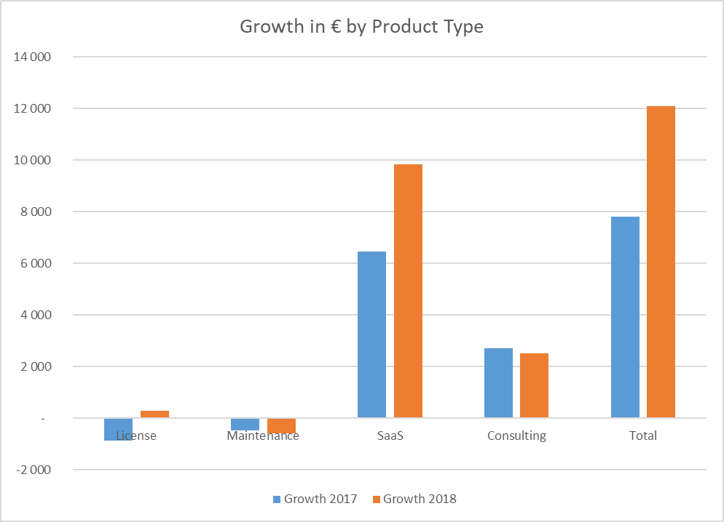
Growth by Product Type
SaaS Growth accelerates and drives overall growth
  €9.8M in 2018
  €6.5M in 2017
  +51%
Consulting growth is stable
  Investment in partners
  Improved consulting productivity
At constant exchange rates

Slide 23
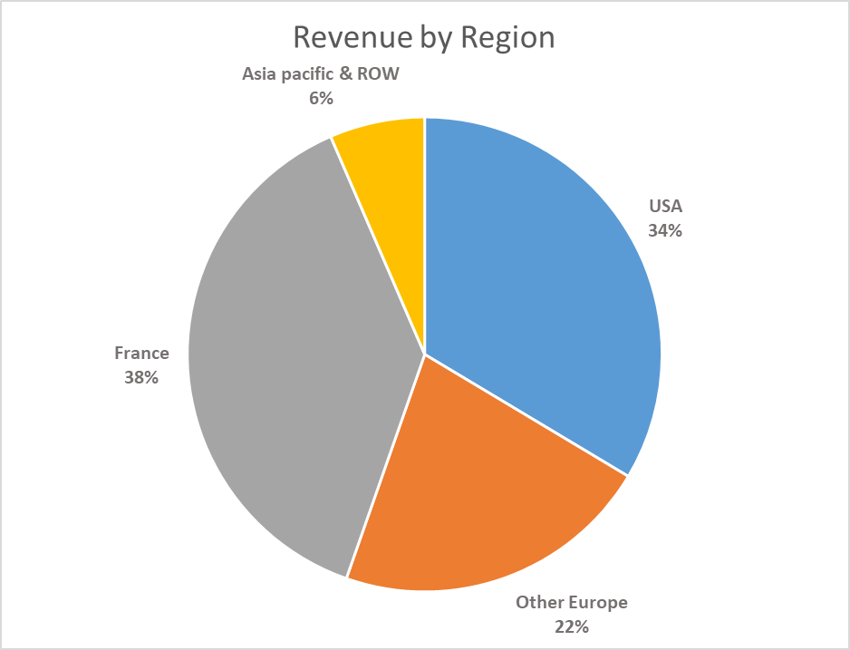
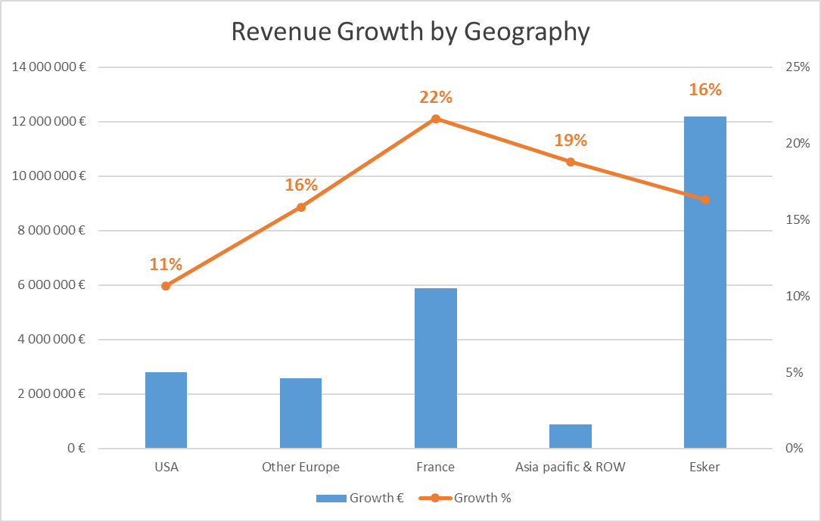
Revenue and Growth by Geography
Dynamic growth across all regions
  France revenue continues to perform very well both through Esker channels and Neopost JV (+€2.2M)
  “Other Europe” shows excellent performance in Germany, Italy and Spain.
  Brexit uncertainty slows down growth in the UK (+6%)
  Asia Pacific maintains high growth rate
  USA growth rate lower due to legacy and on premise revenue. US SaaS revenue on par with rest of the company

Slide 24
Currency Effects (USD)
Rate USD/EURO | Revenue | Operating Income
1.00 | €5,584K | €1,845K
1.137 | €1,159K | €385K
1.179 | €0K | €0K
1.20 | -€537K | -€177K
1.30 | -€2,891K | -€955K

Slide 25
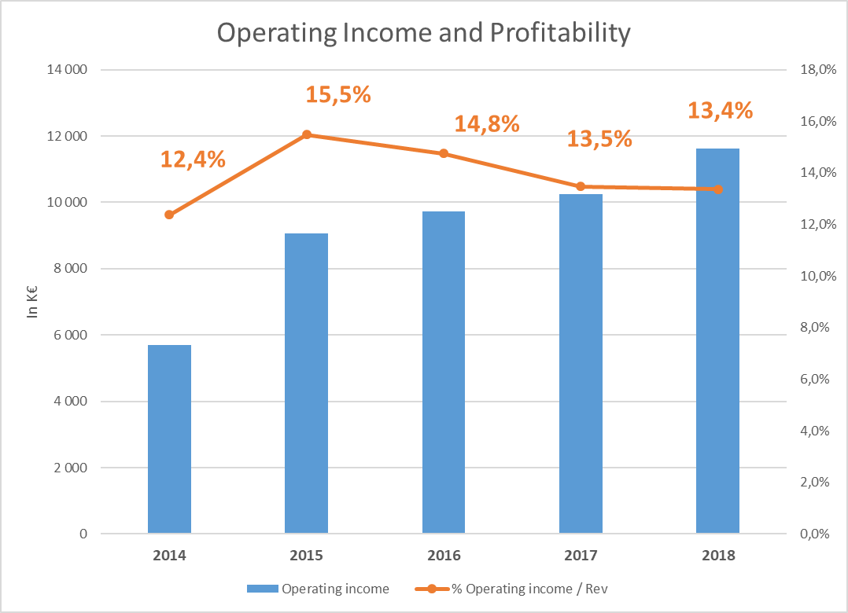
Profitability Overview
Income from operations increase by 13.3%
Profitability stable at 13.4% of revenue despite
  Continued investment in HR for future growth (Headcount +13.5%)
  Unfavorable currency translation impact: €0.5M
  Higher variable compensation cost (Sales, marketing, consulting) due to very high increase in new bookings for 2018: +€1.1M)
.
.
.
.
.

Slide 26
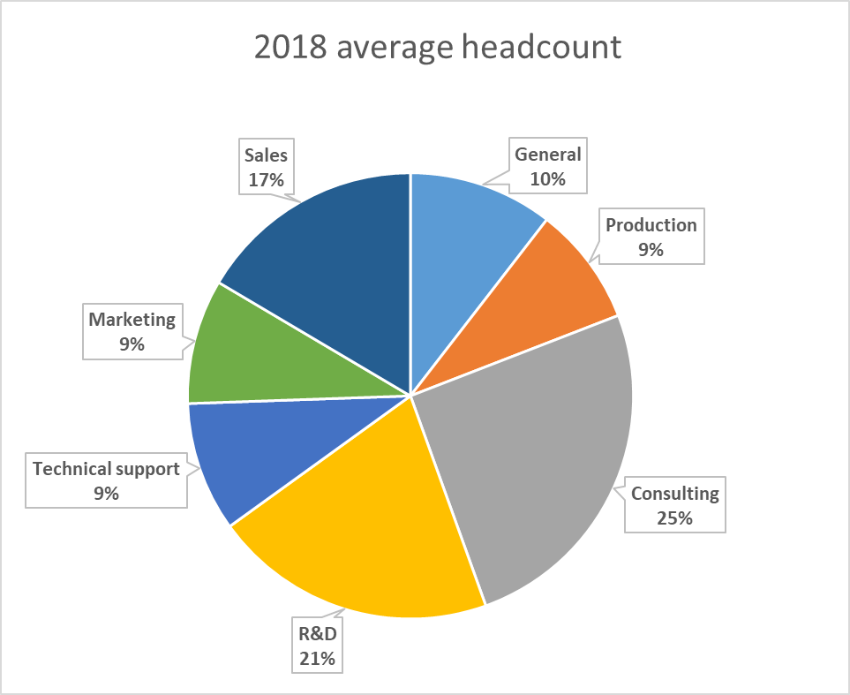
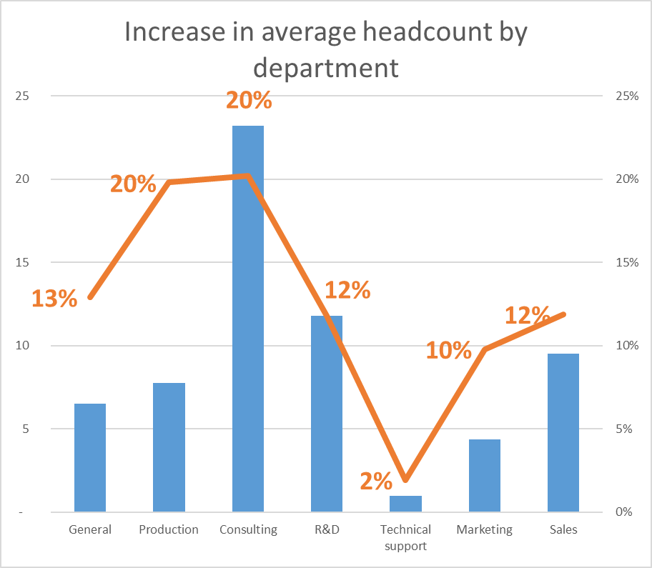
Continued Investment in People
Global HC increase 13.5%
  544 average FTE in 2018. 580 @ 12/31/2018
  +64 FTE vs 2017
  Consulting & R&D represent 56% of overall increase

Slide 27
Income Statement
In '000 of euros | 31/12/2018 | % CA | 31/12/2017 | % CA | Var € | Var %
REVENUE | 86,871 | 100.0% | 76,065 | 100.0% | 10,806 | 14.2%
Capitalized R&D expenses | 5,742 | 6.6% | 5,204 | 6.8% | 538 | 10.3%
Other income | 1,324 | 1.5% | 1,136 | 1.5% | 188 | 16.5%
Personnel cost | -50,015 | -57.6% | -43,216 | -56.8% | -6,799 | 15.7%
Other operating expenses | -24,180 | -27.8% | -21,536 | -28.3% | -2,644 | 12.3%
Taxes | -1,213 | -1.4% | -1,063 | -1.4% | -150 | 14.1%
Depreciation and amortization | -6,918 | -8.0% | -6,342 | -8.3% | -576 | 9.1%
INCOME FROM OPERATIONS | 11,611 | 13.4% | 10,248 | 13.5% | 1,363 | 13.3%
Financial income / (Loss) | -57 | -0.1% | -110 | -0.1% | 53 | -48.2%
OPERATING INCOME | 11,554 | 13.3% | 10,138 | 13.3% | 1,416 | 14.0%
Exceptional items | -88 | -0.1% | -456 | -0.6% | 368 | -80.7%
Income tax | -2,940 | -3.4% | -3,148 | -4.1% | 208 | -6.6%
Affiliates equity method | 317 | 0.4% | 232 | 0.3% | 85 | 36.6%
NET INCOME | 8,843 | 10.2% | 6,766 | 8.9% | 2,077 | 30.7%
Earnings per share | 1.64 |  | 1.28 |  | 0.36 | 28.1%
Fully diluted earnings per share | 1.59 |  | 1.22 |  | 0.37 | 30.3%
 | 2018 | 2017 | Var € | Var %
Development cost capitalized | 5 742 | 5 204 | 538 | 10%
Amortization | (4 137) | (3 634) | (503) | 14%
Net | 1 605 | 1 570 | 35 | 2%
% Capitalized | 62% | 63%

Slide 28
Income Statement by function
In '000 of euros | 31/12/2018 | % CA | 31/12/2017 | % CA | Var € | Var %
REVENUE | 86,871 | 100.0% | 76,065 | 100.0% | 10,806 | 14.2%
Costs of Goods Sold | -12,936 | -14.9% | -12,209 | -16.0% | -727 | 6.0%
Research and Development Expenses | -9,337 | -10.7% | -7,958 | -10.0% | -1,379 | 17.3%
Selling & Consulting Expenses | -36,638 | -42.2% | -31,142 | -41.0% | -5,496 | 17.6%
Marketing Expenses | -8,111 | -9.3% | -7,181 | -9.0% | -930 | 13.0%
General and Administrative Expenses | -8,238 | -9.5% | -7,332 | -10.0% | -906 | 12.4%
INCOME FROM OPERATIONS | 11,611 | 13.4% | 10,248 | 13.5% | 1,363 | 13.3%
Financial income / (Loss) | -57 | -0.1% | -110 | -0.1% | 53 | -48.2%
OPERATING INCOME | 11,554 | 13.3% | 10,138 | 13.3% | 1,416 | 14.0%
Exceptional items | -88 | -0.1% | -456 | -0.6% | 368 | -80.7%
Income tax | -2,940 | -3.4% | -3,148 | -4.1% | 208 | -6.6%
Affiliates equity method | 317 | 0.4% | 232 | 0.3% | 85 | 36.6%
NET INCOME | 8,843 | 10.2% | 6,766 | 8.9% | 2,077 | 30.7%
Earnings per share | 1.64 |  | 1.28 |  | 0.36 | 28.1%
Fully diluted earnings per share | 1.59 |  | 1.22 |  | 0.37 | 30.3%

Slide 29
Consolidated balance sheet
ASSETS (in'000) | 12/31/18 | 12/31/2017 | Var.
Goodwill | 6,082 | 5,858 | 224
Intangible assets | 22,014 | 20,815 | 1,199
Tangible assets | 7,050 | 7,115 | -65
Financial assets | 3,745 | 3,699 | 46
Affiliates equity mehod | 744 | 425 | 319
Total Fixed Assets | 39,635 | 37,912 | 1,723
Inventory | 147 | 176 | -29
Accounts Receivable | 20,516 | 17,633 | 2,883
Deferred Tax Assets | 524 | 762 | -238
Other Assets | 5,035 | 3,620 | 1,415
Cash & Cash Equivalents | 22,794 | 20,632 | 2,162
Total Current Assets | 49,016 | 42,823 | 6,193
TOTAL ASSETS | 88,651 | 80,735 | 7,916
LIABILITIES AND SHAREHOLDERS EQUITY (In '000) | 12/31/18 | 12/31/2017 | Var.
Shareholders Equity | 47,769 | 39,620 | 8,149
Reserves | 1,492 | 1,193 | 299
Long Term Debt | 9,318 | 13,716 | -4,398
Long Term Liabilities | 10,810 | 14,909 | -4,099
Accounts Payable | 6,157 | 4,824 | 1,333
Tax & Social liabilities | 14,415 | 12,451 | 1,964
Deferred Tax Liabilities | 430 | 210 | 220
Other Liabilities | 9,070 | 8,721 | 349
Total Liabilities | 39,390 | 39,922 | -532
TOTAL | 88,651 | 80,735 | 7,916
Intangible assets & goodwill increase due to
  Higher EUR/USD rate (5%)
  Net addition to R&D costs capitalized
Financial assets include €3.1M of LT cash invested in bonds (to be held till maturity)
Affiliates under equity method reflect share in JV with Neopost
Accounts receivable increase in line with revenue
Financial liabilities decrease in line with amortization schedule

Slide 30
Consolidated cash flow statement
in '000 of euros | 12/31/18 | 12/31/2017
Net Consolidated Income | 8,843 | 6,766
Depreciation and Amortization Expense | 7,170 | 7,424
Net income / loss from Sales of Assets | 6 | -56
Income tax Expense VS Paid | 145 | 1,095
Interest income | 120 | 35
Change in Working Capital | -650 | -80
CASH FLOW FROM OPERATING ACTIVITIES | 15,634 | 15,184
Acquisition of Tangible and Intangible Assets | -7,792 | -13,155
Sale of Tangible and Intangible Assets | 279 | 77
Increase in Finacial Assets | -46 | -3,106
Investment in Affiliated Entities | -543 | -3,751
CASH FLOW FROM INESTING ACTIVITIES | -8,102 | -19,935
Dividends Paid | -1,756 | -1633
Proceeds from Stock Options Exercised | 661 | 477
Amortization of Financial Debt | -4,398 | -3,977
Increase in Financial Debt | 0 | 10,000
CASH FLOW FROM FINANCING ACTIVITIES | -5,493 | 4,867
NET CHANGE IN CASH POSITION | 2,039 | 116
Currency impact | 124 | -822
Cash on Hand at Opening | 20,632 | 21,338
Cash on Hand at Closing | 22,794 | 20,632
Cash position increases by €2M and does not include €3.1M on LT investments
Positive cash flow generated by operating activities stable
Finances investing activities:
  €5.7M of capitalized development costs
  €2.1M of investment in cloud infrastructure, improvement of offices and needs from increasing headcount
Increased dividend paid to shareholders
Financial debt continues its amortization schedule

Slide 31
Strategy

Slide 32





Product Roadmap
WE ARE HERE
FINANCE
CYCLE
Payment
Dynamic discounting
Reverse factoring
Factoring
PEOPLE
Supply Chain
Order to Cash
Procure to Pay
PROCESS
Portals
Collaboration
Mobile app
Business network
DOCUMENT
Order Processing
Account Receivable
Accounts Payable
Purchasing
Collaboration
MEDIA
Purchase orders
Customer invoices
Supplier invoices
EDI
Fax
Email
Mail
SMS
VALUE

Slide 33





Technology Roadmap
Artificial Intelligence
(Deep-Learning)
Robotic
Process
Automation (RPA)
Mobile Application
(Esker Anywhere)
Multi-Tenant
Global SaaS Platform
Machine
Learning

Slide 34

Growth Drivers
Plateform & OEM
Partners & Resellers
Productization
New Direct Customers
New Processes

Slide 35
Target 2019 and Beyond
Aiming at 20% recurring organic growth
While keeping profitability around 15%
And maintaining strong investments in Sales, Consulting and R&D along
Notes:
35

Slide 36
addendum

Slide 37
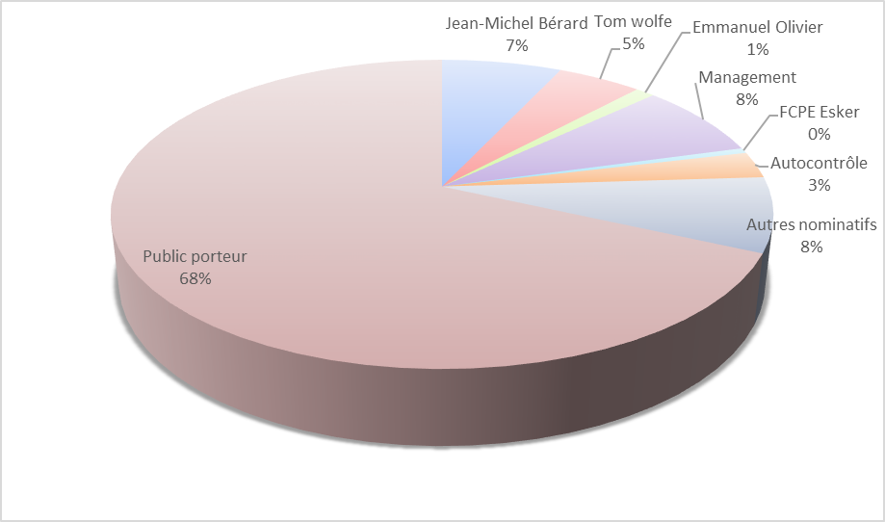
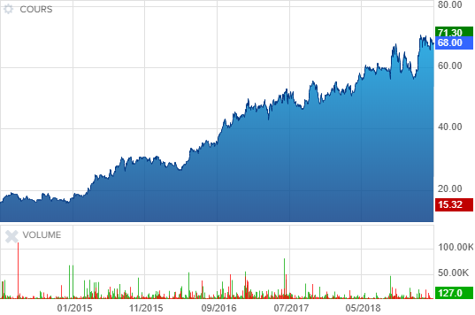
Stock Market
Capital breakdown as of December 31, 2018 (estimated)
Euronext Growth Paris
    ISIN Code: FR0000035818 ALESK
    Market capitalization March 20, 2019: €387M
    Number of shares: 5,608,965
Financial Announcements:
Q1 2019: April 16 2019*
Q2 2019: July 16 2019*
Q3 2019: October 15 2019*
* After stock market closing
Stock Price Evolution over 5 years

Slide 38
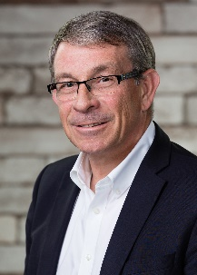
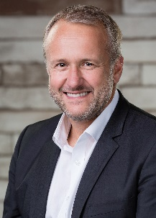
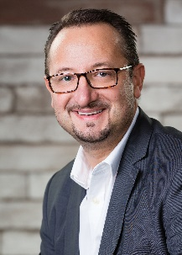
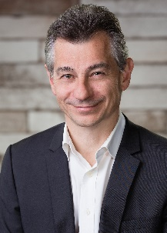
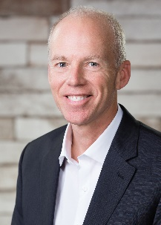
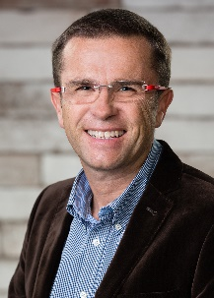
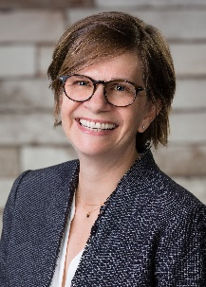
Board of Directors
Jean-Michel Bérard (57)
CEO – President of BoD
Esker founder
Emmanuel Olivier (50)
COO – General Manager
Board Member
Eric Bussy
(44)
WW Corporate Marketing
and Product Management Director
Jean-Jacques Bérard
(52)
Executive Vice President, Research and Development
Steve Smith
(57)
U.S. Chief Operating Officer
Eric Thomas
(50)
Vice President of Business Development
Anne Grand-Clément
(46)
WW Director of Professional Services and Technical Support
Notes:
38

Slide 39























Competition
Order
Management
Purchasing Automation
Accounts
Receivable
Accounts
Payable
Document Delivery

Slide 40

THANK YOU FOR YOUR ATTENTION

